Slide 1

Lecture # 04
Propositional Calculus & Predicate Calculus

Slide 2
Propositional Calculus

Slide 3
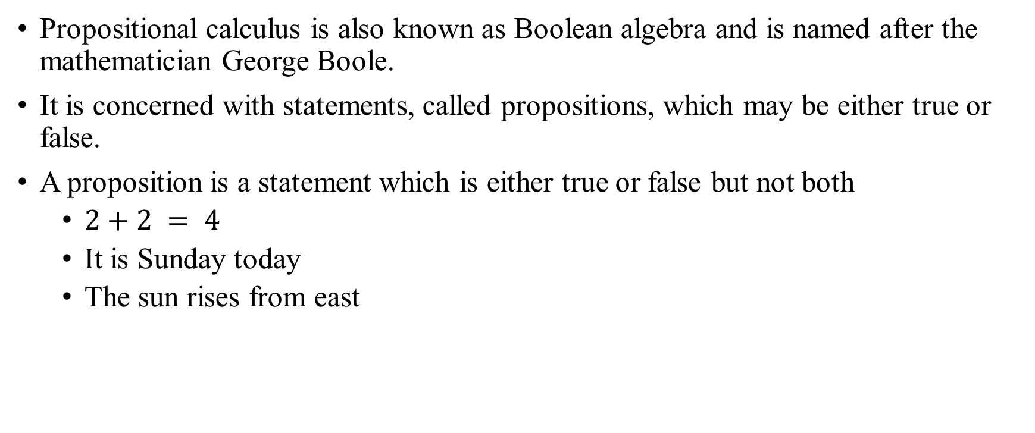
Propositional Calculus
Propositional calculus is also known as Boolean algebra and is named after the mathematician George Boole.
It is concerned with statements, called propositions, which may be either true or false.
A proposition is a statement which is either true or false but not both
$2+2 = 4$
It is Sunday today
The sun rises from east

Slide 4
Propositional Calculus
A statement is a declarative sentence
It is Sunday today (OK)
The sun rises from east (OK)
Open the door (an order; not a statement)
Are you hungry? (Interrogative; not a statement)
A proposition is a statement which is either true or false but not both
$2+2 = 4$
It is Sunday today
The sun rises from east

Slide 5
Truth Values
If a proposition is true, we say that it has a truth value of “true”
If a proposition is false, its truth value is “false”
The truth values “true” and “false” are, respectively, denoted by the letters T and F

Slide 6
Conditional Statements
Propositional Calculus
Let p and q be propositions. The conditional statement p → q is the proposition “if p, then q.” The conditional statement p → q is false when p is true and q is false, and true otherwise.
In the conditional statement p → q, p is called the hypothesis (or antecedent or premise) and q is called the conclusion (or consequence).
The statement p → q is called a conditional statement because p → q asserts that q is true on the condition that p holds.
A conditional statement is also called an implication.

Slide 7
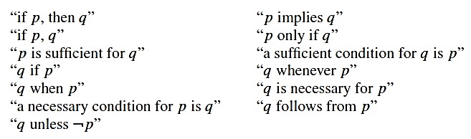
Other forms
Propositional Calculus
Conditional statements play an essential role in mathematical reasoning
Many ways to express an implication (p -> q) :

Slide 8
Biconditionals
Propositional Calculus
Let p and q be propositions. The biconditional statement p ↔ q is the proposition “p if and only if q.”
The biconditional statement p ↔ q is true when p and q have the same truth values, and is false otherwise.
Biconditional statements are also called bi-implications.

Slide 9
Common ways to express p ↔ q
Propositional Calculus
“p is necessary and sufficient for q”
“if p then q, and conversely”
“p iff q”

Slide 10
Example
Propositional Calculus
Let p be the statement “You can take the flight,” and let q be the statement “You buy a ticket.” Then p ↔ q is the statement
“You can take the flight if and only if you buy a ticket.”
p: “You can take the flight”
q: “You buy a ticket”
You can take the flight if and only if you buy a ticket
You can take the flight iff you buy a ticket
The fact that you can take the flight is necessary and sufficient for buying a ticket

Slide 11
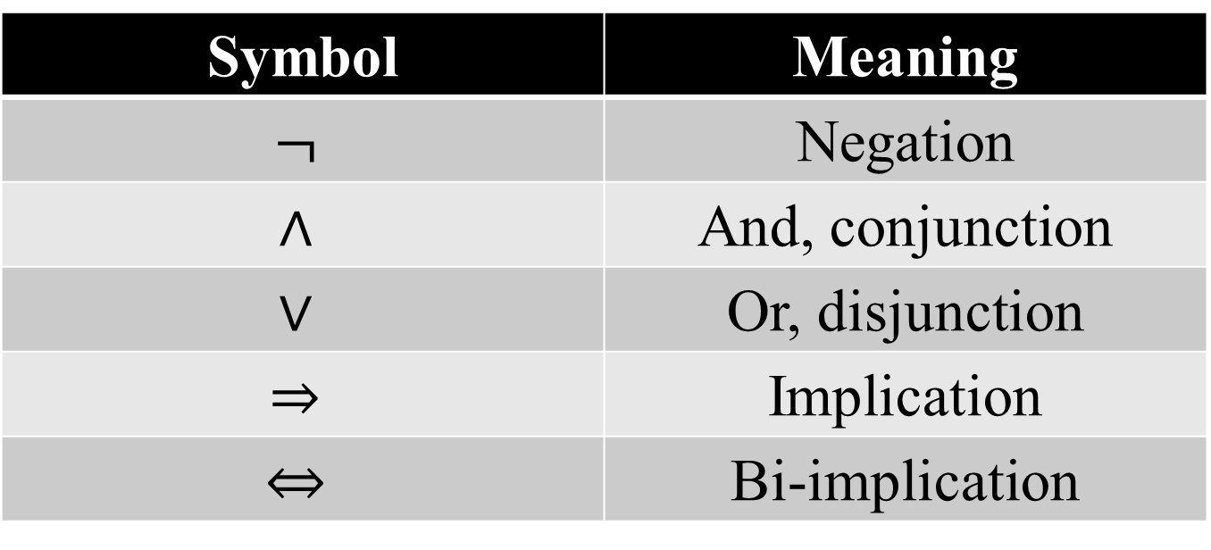
Propositional Calculus – Operators Precedence
Symbol | Meaning
$$¬$$ | Negation
$$∧$$ | And, conjunction
$$∨$$ | Or, disjunction
$$⇒$$ | Implication
$$⇔$$ | Bi-implication

Slide 12
Propositional Calculus - Logical Equivalences
Compound propositions that have the same truth values in all possible cases are called logically equivalent.
The notation p ≡ q denotes that p and q are logically equivalent.

Slide 13
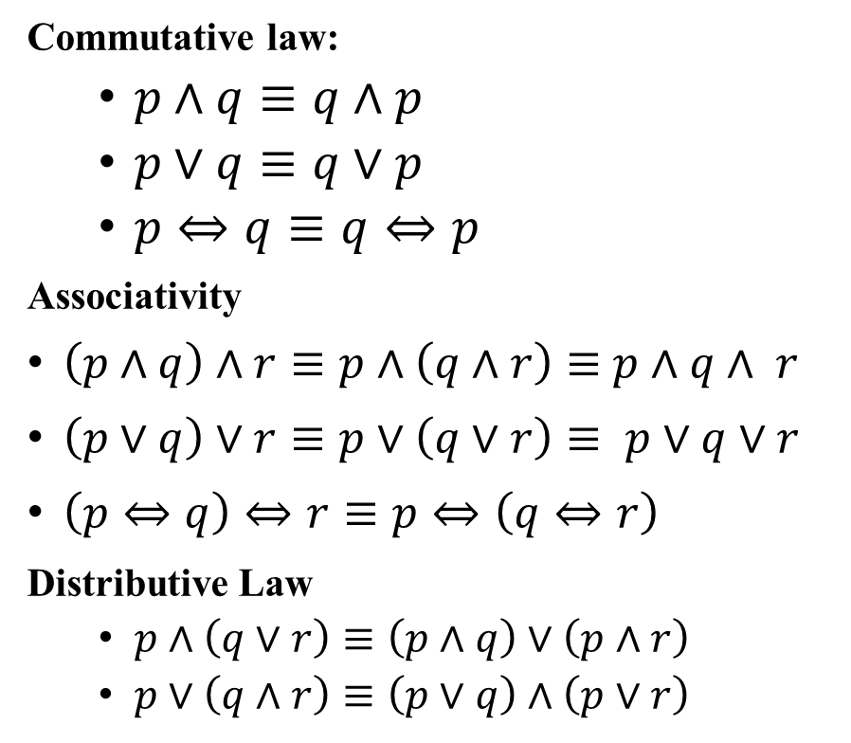
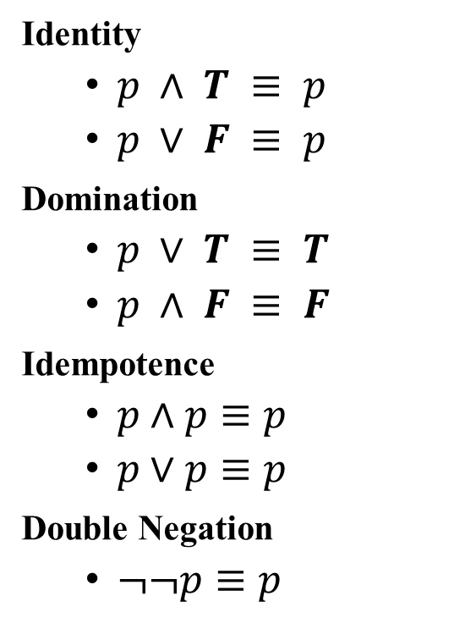

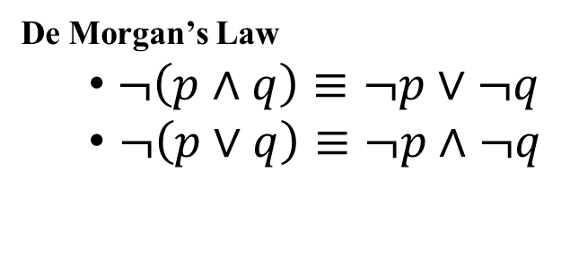
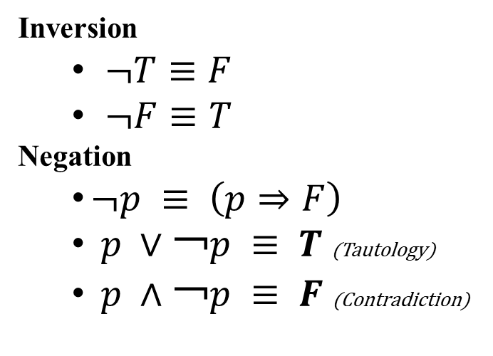
Propositional Calculus - Logical Equivalences
Identity
$p ∧ T ≡ p$
$p ∨ F ≡ p$
Domination
$p ∨ T ≡ T$
$p ∧ F ≡ F$
Idempotence
$p∧p≡p$
$p∨p≡p$
Double Negation
$¬¬p≡p$
Commutative law:
$p∧q≡q∧p$
$p∨q≡q∨p$
$p⇔q≡q⇔p$
Associativity
$\left(p∧q\right)∧r≡p∧\left(q∧r\right)≡$ $p∧q∧ r$
$\left(p∨q\right)∨r≡p∨\left(q∨r\right)≡ p∨q∨r$
$\left(p⇔q\right)⇔r≡p⇔\left(q⇔r\right)$
Distributive Law
$p∧\left(q∨r\right)≡\left(p∧q\right)∨\left(p∧r\right)$
$p∨\left(q∧r\right)≡\left(p∨q\right)∧\left(p∨r\right)$
Inversion
$¬T≡F$
$¬F≡T$
Negation
$¬p ≡ \left(p⇒F\right)$
$p ∨￢p ≡ T$ (Tautology)
$p ∧￢p ≡ F$ (Contradiction)
Absorption laws
$p ∨ \left(p ∧ q\right)≡ p$
$p ∧ \left(p ∨ q\right)≡ p$
De Morgan’s Law
$¬\left(p∧q\right)≡¬p∨¬q$
$¬\left(p∨q\right)≡¬p∧¬q$

Slide 14
Propositional Calculus - Example
EXAMPLE : Part of a system specification contains the sentences
There are only two valid commands which can be typed. They are the CHECKTRAFFIC command and the CHECKPOPULATION command.
Only if a valid command has been typed in by an authorized user will the command be executed normally.
If an invalid command has been typed and an authorized user has typed the command, an invalid command error will be displayed.
Reduce each sentence into propositional calculus form.

Slide 15

Soultion
EXAMPLE : Part of a system specification contains the sentences
There are only two valid commands which can be typed. They are the CHECKTRAFFIC command and the CHECKPOPULATION command.
Only if a valid command has been typed in by an authorized user will the command be executed normally.
If an invalid command has been typed and an authorized user has typed the command, an invalid command error will be displayed.

Slide 16
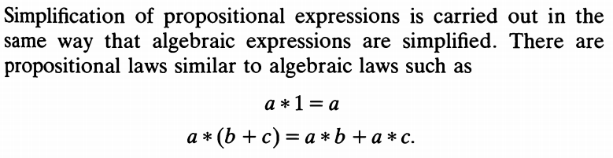
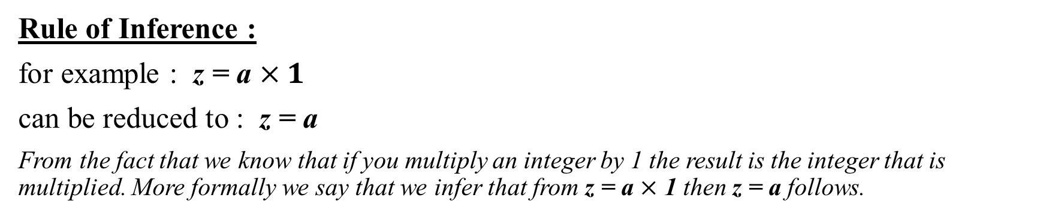
RULE OF INFERENCE & SIMPLIFICATION
Rule of Inference :
for example : z = a $×1$
can be reduced to : z = a
From the fact that we know that if you multiply an integer by 1 the result is the integer that is multiplied. More formally we say that we infer that from z = a $×$ 1 then z = a follows.

Slide 17




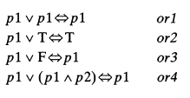
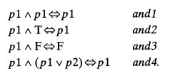



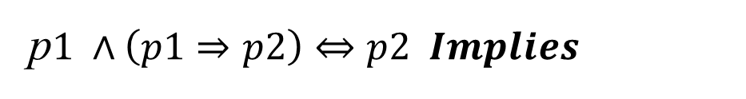
SIMPLIFICATION - Laws
p$1 ∧\left(p1⇒p2\right)⇔p2 Implies$
$$\left(p1⇒p2\right) ∧¬p2⇔￢p1 ImpliesNot$$

Slide 18
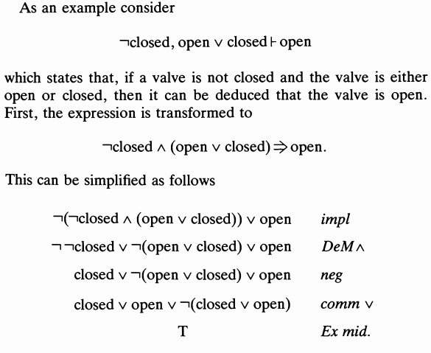
EXAMPLE - 1

Slide 19
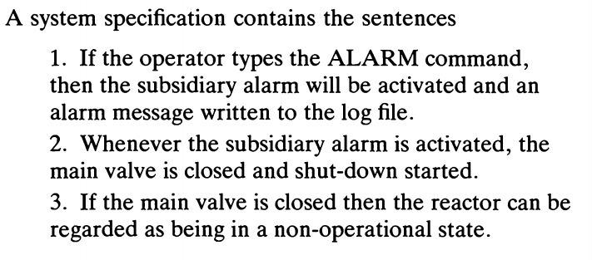
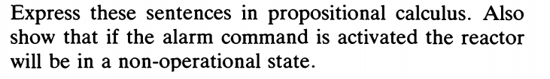
EXAMPLE - 2

Slide 20
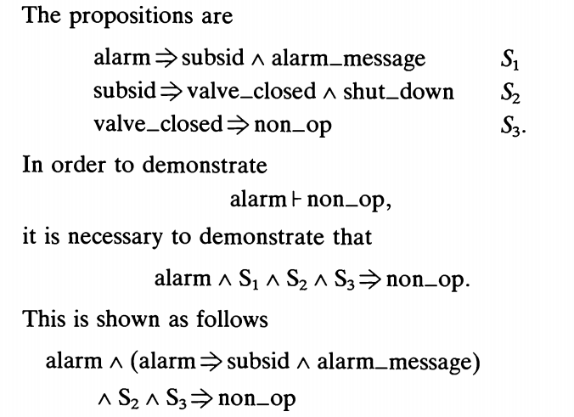
EXAMPLE - 2

Slide 21
Predicate Calculus

Slide 22
Predicate Calculus
A predicate is a statement with a place for an object. There may be many such places within a single predicate;
This is often the case when the objects concerned are mathematical.
When these places are filled, our predicates become statements about the objects that fill them.

Slide 23
Predicate Calculus
For example, the statement ` __ > 5' is a predicate.
As it stands, it is not a proposition;
we cannot say whether it is true or false until we have filled the empty place.
We could turn it into a proposition by putting 0 in this place; the
result would be `0 > 5', a proposition that happens to be false.
This is not the only way to fill a gap, however. We could also choose to put an object variable in the empty place above.

Slide 24
Predicate Calculus
The predicate `x > 5' is still not a proposition; we cannot say whether it is true or false without knowing what x is.
The use of object variables is a powerful technique in expressing the universal and existential properties.
We can make a proposition out of `x > 5' by adding a quantifier to the front of the expression.
For example, we could state that `there is an x, which is a natural number, such that x > 5'.
Here, the quantifier is `there is an.', and we have quantified the predicate `x > 5' to produce a true proposition.

Slide 25
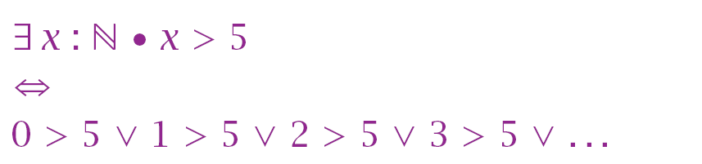
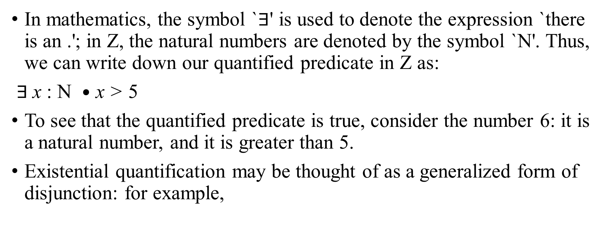
Predicate Calculus
In mathematics, the symbol `$∃$' is used to denote the expression `there is an .'; in Z, the natural numbers are denoted by the symbol `N'. Thus, we can write down our quantified predicate in Z as:
$∃$x : N $•$ x > 5
To see that the quantified predicate is true, consider the number 6: it is a natural number, and it is greater than 5.
Existential quantification may be thought of as a generalized form of disjunction: for example,

Slide 26

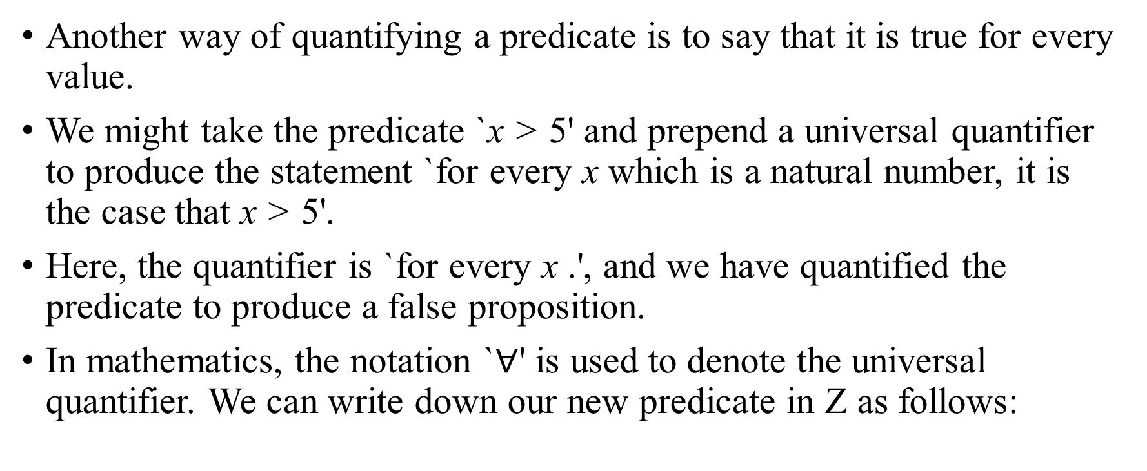
Predicate Calculus
Another way of quantifying a predicate is to say that it is true for every value.
We might take the predicate `x > 5' and prepend a universal quantifier to produce the statement `for every x which is a natural number, it is the case that x > 5'.
Here, the quantifier is `for every x .', and we have quantified the predicate to produce a false proposition.
In mathematics, the notation `$∀$' is used to denote the universal quantifier. We can write down our new predicate in Z as follows:

Slide 27
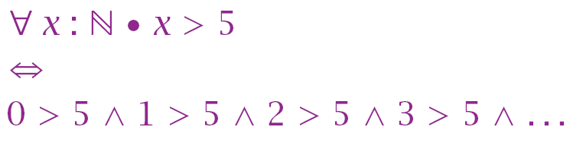
Predicate Calculus
This predicate is false because not every natural number x is greater than 5: consider 3.
The universal quantifier may be thought of as a generalized conjunction: for example

Slide 28
Predicate Logic
Universal Quantifiers $∀$
For All, For Every, For Any
“All natural numbers are greater than or equal to zero”
$∀$n : N $∙n ≥0$
In general, $∀$x : X $∙$ P(x) abbreviates P(a) $˄$ P(b) $˄$ P(b)….
Are the following true or false?
$∀$n : N $∙n2 ≥0$
$∀$n : N $∙(n2$== n) $→$(n=0) ˅ (n=1)

Slide 29
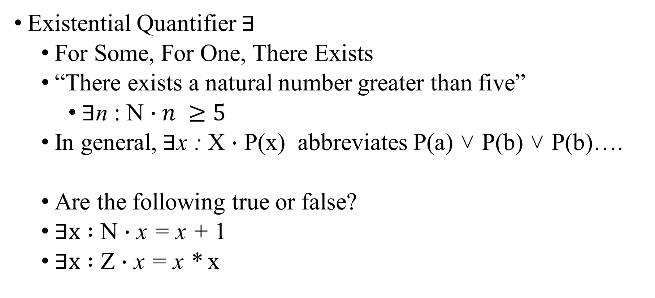
Predicate Logic
Existential Quantifier $∃$
For Some, For One, There Exists
“There exists a natural number greater than five”
$∃$n : N $∙n ≥5$
In general,$∃$x : X $∙$ P(x) abbreviates P(a) ˅ P(b) ˅ P(b)….
Are the following true or false?
$∃x :$ N $∙$ x = x + 1
$∃x :$ Z $∙$ x = x * x

Slide 30
REFERENCES :
D. Ince-An Introduction to Discrete Mathematics, Formal System Specification and Z. (Oxford Applied Mathematics and Computing Science Series) – Chapter 3

